Slide 1
Deep Learning
Pratap Dangeti

Slide 2
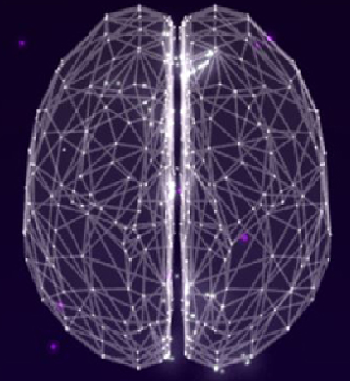
Table of Contents
1
Deep Learning Requirement
2
Introduction
3
Fundamentals
4
Deep Architecture of ANN
5
Convolutional Neural Networks
6
Recurrent Neural Networks
7
Deep Autoencoders
8
Conclusions and Further Readings

Slide 3
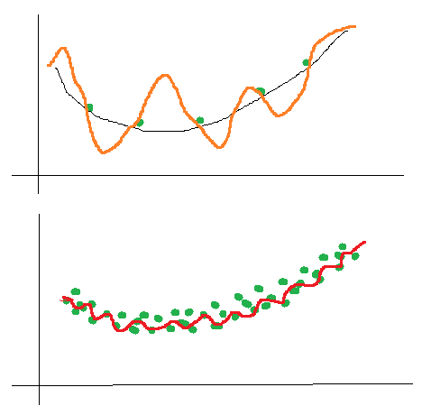
Deep Learning Requirement
Over the period of time, more drive for Automation, Artificial Intelligence (E.g.: Autonomous Car, Alphago from Google Deepmind)
Some problems cannot be mathematically programmed exclusively, instead make machines learn by itself E.g.: Face recognition
Over the period, percentage of unstructured data has grown to about 90% of total data E.g.: Pictures, Twitter chats, YouTube videos, WhatsApp Logs etc. Deep Learning is well suited for Picture, Audio and Language processing etc.
Highly non linear models can be fitted on Big Data without much issue of over fitting
High capacity computational power for cheap makes the tedious calculations very possible to implement
Fitting Highly Non linear model on Small Data Vs Big Data

Slide 4
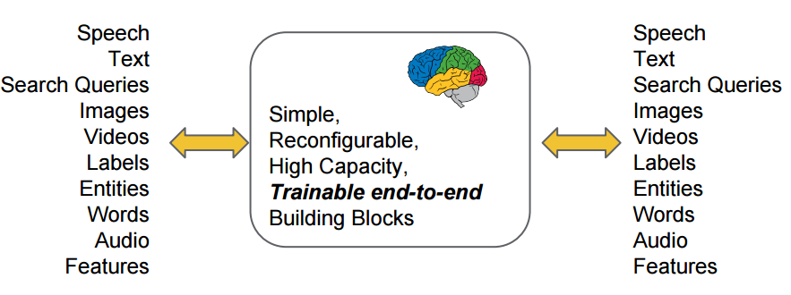
Diversified Utility of Deep Learning

Slide 5
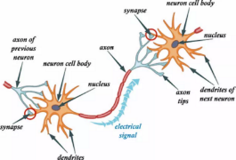
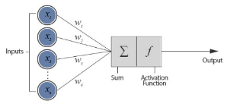
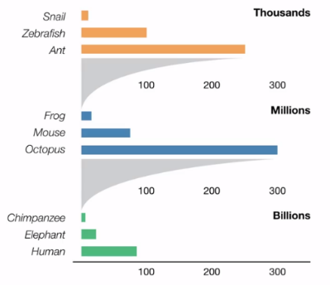
Introduction
Biological Neuron
Artificial Neuron
Deep learning is a form of machine learning that uses a model of computing that's very much inspired by the structure of the brain. Hence we call this model a neural network. The basic foundational unit of a neural network is the neuron)
Each neuron has a set of inputs, each of which is given a specific weight. The neuron computes some function on these weighted inputs. A linear neuron takes a linear combination of the weighted inputs and apply activation function (sigmoid, tanh etc.)
Network feeds the weighted sum of the inputs into the logistic function (in case of sigmoid activation function). The logistic function returns a value between 0 and 1. When the weighted sum is very negative, the return value is very close to 0. When the weighted sum is very large and positive, the return value is very close to 1
Number of Neurons in Species

Slide 6
Introduction
Softwares used in Deep Learning
Theano: Python based Deep Learning Library
TensorFlow: Google’s Deep Learning library runs on top of Python/C++
Keras / Lasagne: Light weight wrapper which sits on top of Theano/TensorFlow, enables faster model prototyping
Torch: Lua based Deep Learning library with wide support for machine learning algorithms
Caffe: Deep Learning library primarily used for processing pictures
Useful online Courses
CS231n: Convolutional Neural Networks for Visual Recognition from Stanford university by Andrej Karpathy, Justin Johnson (http://cs231n.stanford.edu/syllabus.html)
Machine Learning from Oxford university by Nando de Freitas (https://www.cs.ox.ac.uk/people/nando.defreitas/machinelearning/)
Neural Networks for Machine Learning from University of Toronto by Geff Hinton (https://www.coursera.org/course/neuralnets)
CS224d: Deep Learning for Natural Language Processing from Stanford university by Richard Socher (http://cs224d.stanford.edu/)

Slide 7
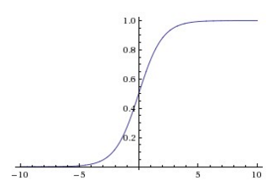
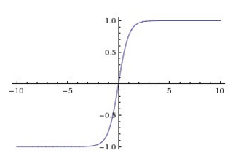
.
Fundamentals
Sigmoid Activation Function
Activation Functions: Every activation function takes a single number and performs a certain fixed mathematical operation on it. Below are popularly used activation functions in Deep Learning
Sigmoid
Tanh
Relu
Linear
Sigmoid: Sigmoid has mathematical form σ(x) = 1 / (1+e^{−x}). It takes real valued number and squashes it into range between 0 and 1. Sigmoid is popular choice, which makes ease of calculating derivatives and easy to interpret
Tanh: Tanh squashes the real valued number to the range [-1,1]. Output is zero centered. In practice tanh non-linearity is always preferred to the sigmoid nonlinearity. Also, it can be proved that Tanh is scaled sigmoid neuron tanh(x) = 2σ(2x) − 1
Tanh Activation Function

Slide 8
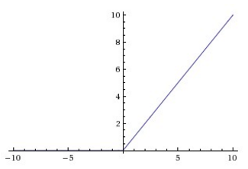
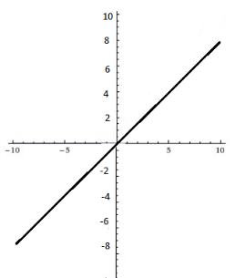
.
Fundamentals
ReLU Activation Function
ReLU (Rectified Linear Unit): ReLU has become very popular in last few years. It computes the function f(x)=max(0,x). Activation is simply thresholds at zero
Linear: Linear activation function is used in Linear regression problems where it provides derivative always as 1 due to the function used is f(x) = x
Relu is now popularly being used in place of Sigmoid or Tanh due to its better property of convergence
Linear Activation Function

Slide 9
Fundamentals
Forward Propagation of Layer 1 Neurons
Forward propagation & Backpropagation: During the forward propagation stage, features are input to the network and feed through the subsequent layers to produce the output activations.
However, we can calculate error of the network only at the output units but not in the middle/hidden layers. In order to update the weights to optimal, we must propagate the network’s errors backwards through its layers
Hidden Layer 1
Hidden Layer 2
BiasWeight1
Input Layer
Hidden1
Hidden4
Output Layer
Input 1
Weight1
Output1
Weight2
Hidden2
Hidden5
Input 2
Output2
Forward Propagation of Layer 2 Neurons
Hidden3
Hidden6
Hidden Layer 1
Hidden Layer 2
BiasWeight4
Activation = g(BiasWeight1 + Weight1 * Input1 + Weight2 * Input2)
Input Layer
Hidden1
Weight7
Hidden4
Output Layer
Input 1
Weight8
Output1
Hidden2
Hidden5
Input 2
Weight9
Output2
Hidden3
Hidden6
Activation = g(BiasWeight4 + Weight7 * Hidden1 + Weight8 * Hidden2+ Weight9 * Hidden3)

Slide 10
Fundamentals
Forward Propagation of Output Layer Neurons
Backpropagation of Output Layer Neurons
Hidden Layer 1
Hidden Layer 2
Hidden Layer 1
Hidden Layer 2
Output Layer
Output Layer
Input Layer
Hidden1
Hidden4
BiasWeight7
Input Layer
Hidden1
Hidden4
Input 1
Weight16
Output1
Input 1
Output1
Hidden2
Hidden5
Weight17
Hidden2
Hidden5
Input 2
Output2
Input 2
Output2
Weight18
Hidden3
Hidden6
Hidden3
Hidden6
Activation = g(BiasWeight7 + Weight16 * Hidden4 + Weight17 * Hidden5+ Weight18 * Hidden6)
Error (Output 1)= g’(Output 1) * (True1 – Output1)

Slide 11
Fundamentals
Backpropagation of Hidden Layer2 Neurons
Backpropagation of Hidden Layer1 Neurons
Hidden Layer 1
Hidden Layer 2
Hidden Layer 1
Hidden Layer 2
Output Layer
Output Layer
Input Layer
Hidden1
Hidden4
Input Layer
Hidden1
Weight7
Hidden4
Input 1
Weight16
Output1
Input 1
Output1
Hidden2
Weight10
Hidden2
Hidden5
Hidden5
Weight19
Output2
Input 2
Output2
Input 2
Weight13
Hidden3
Hidden6
Hidden3
Hidden6
Error (Hidden4)= g’(Hidden4) + (Weight16 * Error(Output1) + Weight19 * Error(Output2))
Error (Hidden1)= g’(Hidden1) * (Weight7 * Error(Hidden4) + Weight10 * Error(Hidden5) + Weight13*Error(Hidden6))

Slide 12
Fundamentals
Updating Weights of Hidden Layer 1 – Input Layer during Backpropagation
Updating Weights of Hidden Layer 1 – Hidden Layer 2 during Forward Propagation
Hidden Layer 1
Hidden Layer 2
Hidden Layer 1
Hidden Layer 2
BiasWeight1
BiasWeight4
Output Layer
Output Layer
Input Layer
Hidden1
Hidden4
Input Layer
Hidden1
Weight7
Hidden4
Weight1
Input 1
Weight2
Output1
Input 1
Output1
Weight8
Hidden2
Hidden5
Hidden2
Hidden5
Input 2
Output2
Input 2
Weight9
Output2
Hidden3
Hidden6
Hidden3
Hidden6
BiasWeight1= BiasWeight1 + a * Error(Hidden1) * 1
Weight1 = Weight1 + a * Error(Hidden1) * Input1
Weight2 = Weight2 + a * Error(Hidden1) * Input2
BiasWeight4= BiasWeight4 + a * Error(Hidden4) * 1
Weight7 = Weight7 + a * Error(Hidden4) * Hidden1
Weight8 = Weight8 + a * Error(Hidden4) * Hidden2
Weight9 = Weight9 + a * Error(Hidden4) * Hidden3

Slide 13
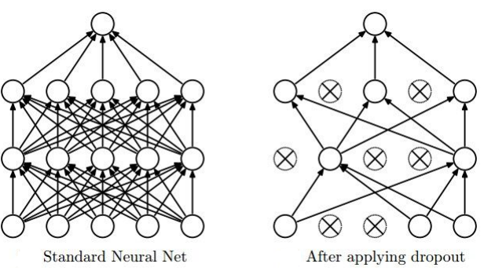
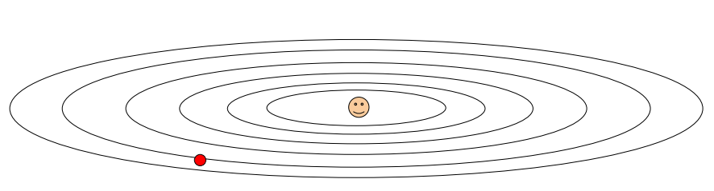
Fundamentals
Application of Dropout in Neural network
Dropout: Dropout is a regularization in Neural networks to avoid over fitting the data. Typically Dropout is 0.8 (80 % neurons present randomly all the time) in initial layers and 0.5 in middle layers
Optimization: Various techniques used to optimize the weights including
SGD (Stochastic Gradient Descent)
Momentum
Nag (Nesterov Accelerated Gradient)
Adagrad (Adaptive gradient)
Adadelta
Rmsprop
Adam (Adaptive moment estimation)
In practice Adam is good default choice, if you cant afford full batch updates, then try out L-BFGS
Optimization of Error Surface

Slide 14
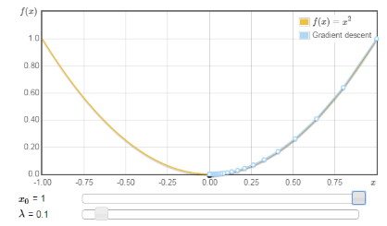
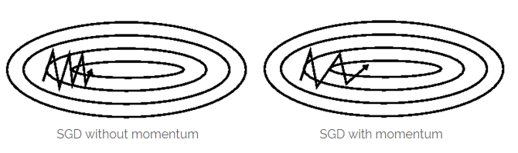
Fundamentals
Stochastic Gradient Descent (SGD): Gradient descent is a way to minimize an objective function J(θ) parameterized by a model’s parameter θ∈R^{d} by updating the parameters in the opposite direction of the gradient of the objective function w.r.to the parameters. Learning rate determines the size of steps taken to reach minimum.
Batch Gradient Descent (all training observations per each iteration)
SGD (1 observation per iteration)
Mini Batch Gradient Descent (size of about 50 training observations for each iteration)
Momentum: SGD has trouble navigating surface curves much more steeply in one dimension than in other, in these scenarios SGD oscillates across the slopes of the ravine while only making hesitant progress along the bottom towards the local optimum
(When using momentum we push a ball down a hill. Ball accumulates momentum as it rolls downhill, becoming faster and faster on the way until it stops (due to air resistance etc.) similarly momentum
term increases for dimensions whose gradients point in the same direction and reduces updates for dimensions whose gradients change directions. As a result, we gain faster convergence and reduced oscillations)
Gradient Descent
Comparison of SGD without & with Momentum

Slide 15
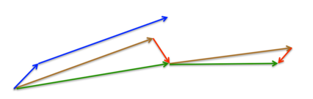
Fundamentals
Nesterov Momentum Update
Nesterov Accelerated Gradient (NAG): If a ball rolls down a hill and blindly follows a slope, is highly unsatisfactory and it should have a notion of where it is going so that it knows to slow down before the hill slopes up again. NAG is a way to give momentum term this kind of prescience
(While momentum first computes the current gradient (small blue vector) and then takes a big jump in the direction of the updated accumulated gradient (big blue vector), NAG first makes a big jump in the direction of the previous accumulated gradient (brown vector), measures the gradient and then makes a correction (green vector). This anticipatory update prevents the ball from going too fast and results in increased responsiveness and performance)
Adagrad: Adagrad is an algorithm for gradient-based optimization that adapts the differential learning rate to parameters, performing larger updates for infrequent and smaller updates for frequent parameters
(Adagrad greatly improves the robustness of SGD and used it to training large-scale neural nets. One of the Adagrad’s main benefits is that it eliminates the need to manually tune the learning rate. Most implementations use a default value of 0.01 and leave it at that.
Adagrad's main weakness is its accumulation of the squared gradients in the denominator: Since every added term is positive, the accumulated sum keeps growing during training. This in turn causes the learning rate to shrink and eventually become infinitesimally small, at which point the algorithm is no longer able to acquire additional knowledge. The following algorithms aim to resolve this flaw.)

Slide 16
Fundamentals
Adadelta: Adadelta is an extension of Adagrad that seeks to reduce its aggressive, monotonically decreasing learning rate. Instead of accumulating all past squared gradients, Adadelta restricts the window of accumulated past gradients to some fixed size w
(Instead of inefficiently storing W previous squared gradients, the sum of gradients is recursively defined as a decaying average of all past squared gradients)
RMSprop: RMSprop and Adadelta have both developed independently around the same time to resolve Adagrad’s radically diminishing learning rates
(RMSprop as well divides the learning rate by an exponentially decaying average of squared gradients)
Adam (Adaptive Moment Estimation): Adam is another method that computes adaptive learning rates for each parameter. In addition to storing an exponentially decaying average of past squared gradients like Adadelta and RMSprop, Adam also keeps an exponentially decaying average of past gradients similar to momentum
In practice Adam gives best results. For complete details on all methods refer: http://sebastianruder.com/optimizing-gradient-descent/index.html#batchgradientdescent

Slide 17
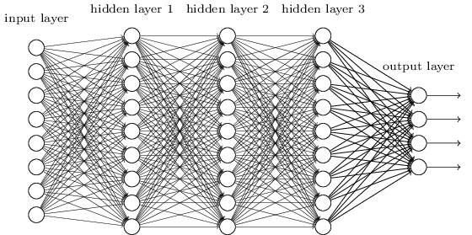
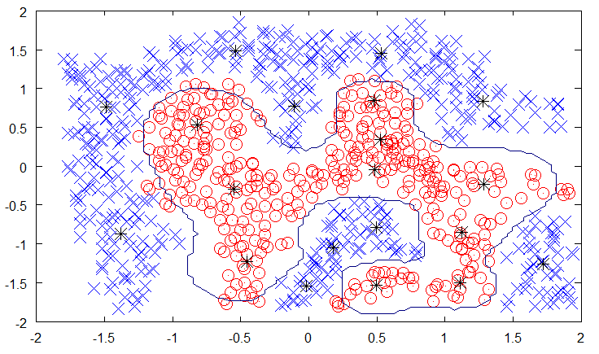
Deep Architecture of ANN (Artificial Neural Network)
Deep Architecture
In Multi Layer /Deep Architecture, each layer is fully connected with the subsequent layer. Output of each artificial neuron in a layer is an input to every artificial neuron in the next layer towards the output
Solving Methodology: Back propagation used to solve deep layers by calculating the error of the network at output units and propagate back through layers
Thumb rules:
All hidden layers should have same number of neurons per layer
Typically 2 hidden layers are good enough to solve majority of problems
Using scaling/batch normalization (mean 0, variance 1) for all input variables after each layer improves convergence effectiveness
Reduction in step size after each iteration improves convergence, in addition to usage of momentum & Dropout
Decision Boundary of Deep Architecture

Slide 18

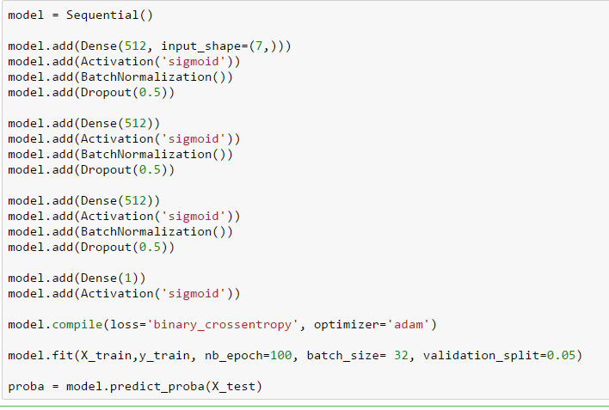
Deep Architecture of ANN (Artificial Neural Network)
Probability of Survival in Titanic Disaster
Case Study: To predict the survival (0 or 1) on Titanic based on few characteristics like Class, Age, Gender, Fare etc.
Hidden Layer 1
Method | Test score | Settings
ANN | 0.7799 | 512-512-512-1, nb_epoch = 100, batchsize = 32
Adaboost | 0.77033 | ntree = 100, lrate = 0.04, algo = SAMME.R
Randomforest | 0.77033 | ntree = 100, maxdepth = 4, criteria = gini,max_features = auto
Gradientboost | 0.76555 | ntree = 100, lrate = 0.04, maxdep =5, maxfeatures = auto
XGBoost | 0.76077 | ntree = 100, lrate = 0.04, maxdep = 5
Logistic Regression | 0.7512 | NA
Hidden Layer 2
Hidden Layer 3
Output Layer

Slide 19
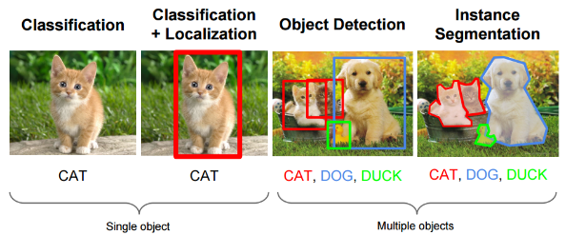
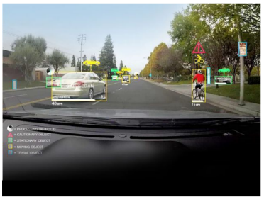
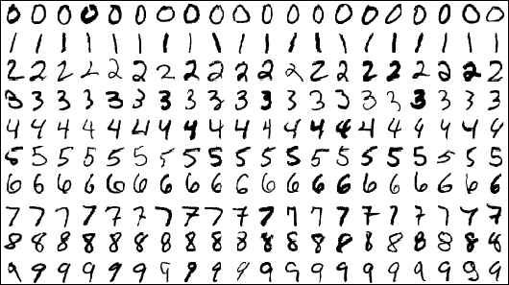
Convolutional Neural Networks
Object recognition and classification using Convolutional Networks
Convolutional Neural Networks used in picture analysis, including image captioning, digit recognizer and various visual system processing E.g.: Vision detection in Self driving cars, Hand written Digit recognizer, Google Deepmind’ s Alphago
CNN application in Self Driving Cars
CNN application in Handwritten Digit Recognizer

Slide 20
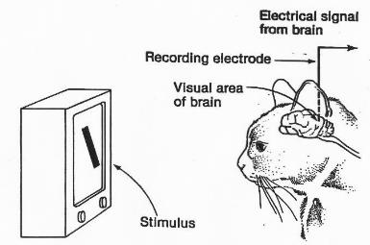
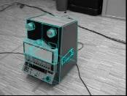
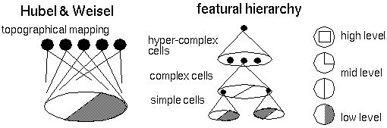
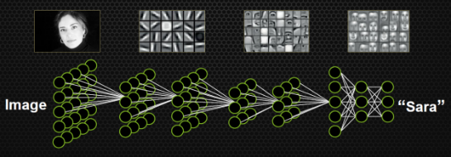
Convolutional Neural Networks
Hubel & Wiesel inserted microscopic electrodes into the visual cortex of anesthetized cat to read activity of the single cells in visual cortex while presenting various stimuli to it’s eyes during experiment on 1959. For which received noble prize under Medicine category on 1981
Hubel & Wiesel discovered that vision is hierarchical, consists of simple cells, complex cells & hyper-complex cells
Hubel & Weisel experiments on Cat’s Vision
Object detection using Edges
Vision is Hierarchical phenomenon
Formation of features over layers using Neural Networks

Slide 21
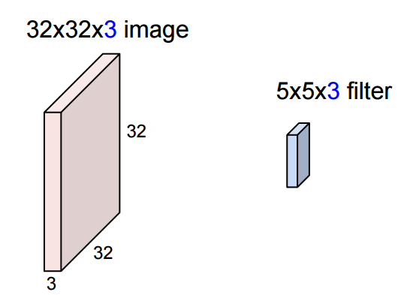
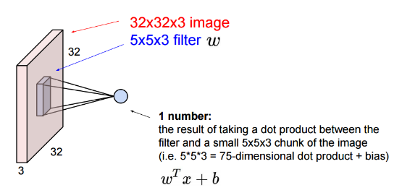
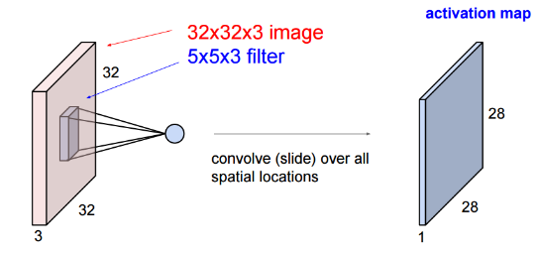
Convolutional Neural Networks
Input Layer & Filter
Input layer/picture consists of 32 x 32 pixels with 3 colors (Red, Green & Blue) (32 x 32 x 3)
Convolution layer is formed by running a filter (5 x 5 x 3) over Input layer which will result in (28 x 28 x 1)
Running filter over Input Layer to form Convolution layer
Complete Convolution Layer from filter

Slide 22
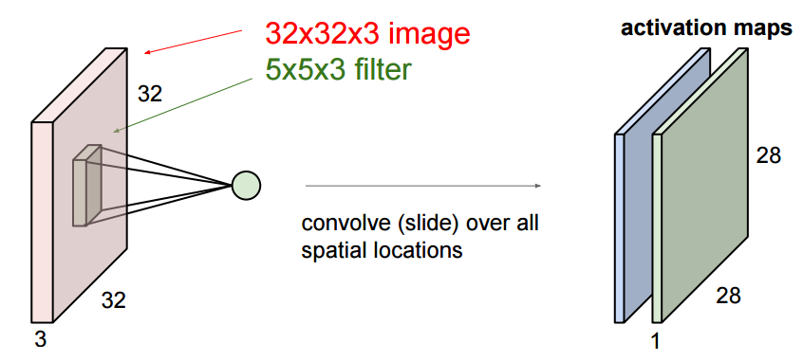
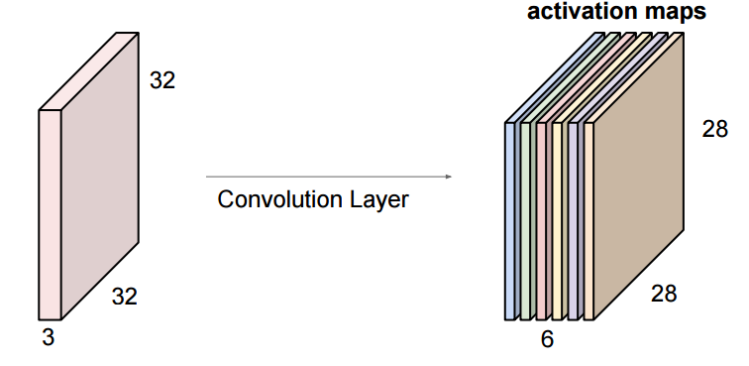
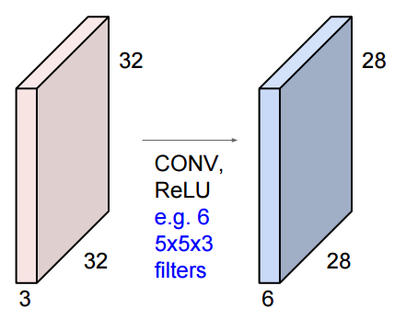
Convolutional Neural Networks
Complete Convolution layer from Filter 2
2nd Convolution layer has been created in similar way with another filter
After striding/convolving with 6 filters, new layer has been created with 28 x 28 x 6 dimension
Convolution layers created with 6 Filters
Formation of complete 2nd layer

Slide 23
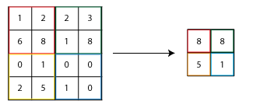
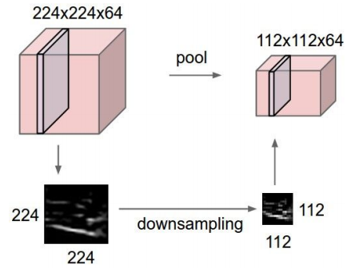
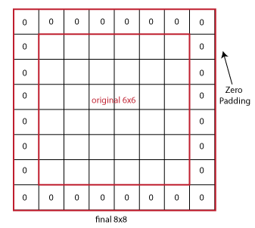
Convolutional Neural Networks
Max pooling working methodology
Pooling Layer: Pooling layer makes the representation smaller and more manageable. Operates over each activation map independently. Pooling applies on width and breadth of the layer and depth will remains the same during pooling stage
Padding: Size of the image (width & breadth) is getting shrunk consecutively, this issue is undesirable during deep networks, padding keeps the size of picture constant or controllable in size throughout the network
Max pool layer after performing pooling
Zero padding on 6 x 6 picture

Slide 24
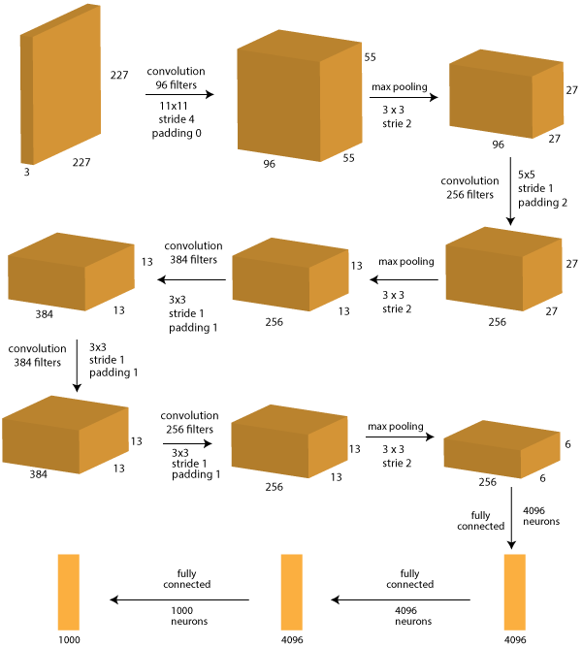
Convolutional Neural Networks
Alex Net for IMAGENET Challenge 2012
Alex net Architecture: Alex Net won the IMAGENET challenge competition during 2012
Layer 0: Input image (227 * 227 * 3 ~= 150k)
Layer 1: Convolution with 96 filters, size 11×11, stride 4, padding 0
Layer 2: Max-Pooling with 3×3 filter, stride 2
Layer 3: Convolution with 256 filters, size 5×5, stride 1, padding 2
Layer 4: Max-Pooling with 3×3 filter, stride 2
Layer 5: Convolution with 384 filters, size 3×3, stride 1, padding 1
Layer 6: Convolution with 384 filters, size 3×3, stride 1, padding 1
Layer 7: Convolution with 256 filters, size 3×3, stride 1, padding 1
Layer 8: Max-Pooling with 3×3 filter, stride 2
Layer 9: Fully Connected with 4096 neuron
Layer 10: Fully Connected with 4096 neuron
Layer 11: Fully Connected with 1000 neurons (classes to predict)
Total memory required 24M * 4 bytes ~= 93 MB/image (only forward !~ *2 for bwd)

Slide 25
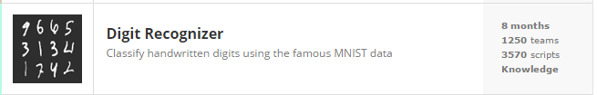
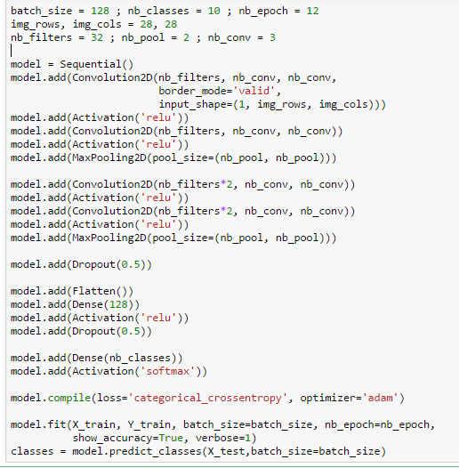
Convolutional Neural Networks
Case Study: kaggle Digit recognizer to recognize handwritten digits
Following implementation made the score 0.99314 (ideal score 1) 46th rank (3.5 %) out of 1314 teams in Public Leaderboard
Digit Recognizer to classify Hand Written digits
}
Layer 1 consists of 2 Convolutional layers followed by Max pooling layer
}
Layer 2 consists of 2 Convolutional layers followed by Max pooling layer
}
Layer 3 consists of Dense network with Dropout 0.5
Layer 4 is Softmax layer for multiclass (10) outputs

Slide 26
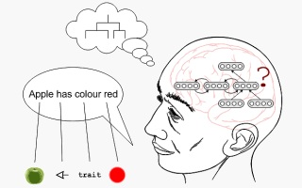
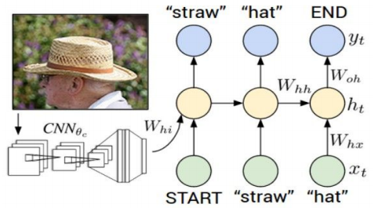
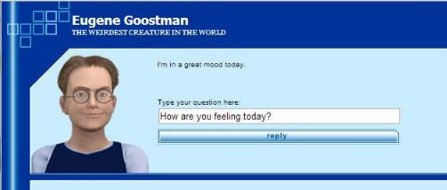
Recurrent Neural Networks
Recurrent Neural Networks
Recurrent neural networks are very much useful in sequence remembering, time series forecasting, Image captioning, machine translation etc.
RNNs are useful in building A.I. Chabot in which sequence of words with all syntaxes & semantics would be remembered and subsequently provide answers to given questions
Image Captioning using Convolutional and Recurrent Neural Network
Application of RNN in A.I. Chatbot

Slide 27
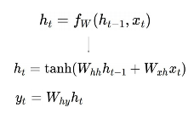
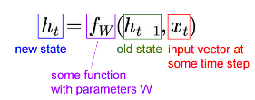

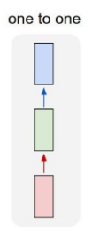
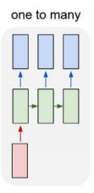
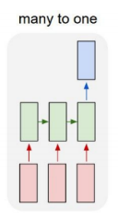
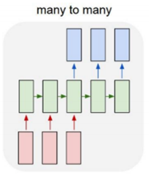
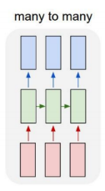
Recurrent Neural Networks
Recurrent Neural Network
Recurrent neural network is used for processing sequence of vectors x by applying a recurrence formula at every time step
y_{t}
y₀
y₁
y₂
y_{t}
RNN
RNN
RNN
RNN
RNN
x_{t}
x₀
x₁
x₂
x_{t}
Vanilla Network
Image Captioning
(image -> Seq. of words)
Sentiment Classification
(Seq. of words -> Sentiment)
Machine Translation
(Seq. of words -> Seq. of words)
Video Classification on frame level

Slide 28
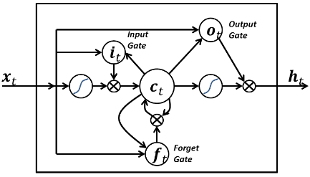
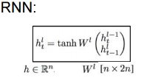
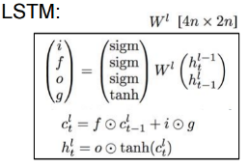

Recurrent Neural Networks
LSTM Cell
Vanishing gradient problem with RNN: Gradients do vanishes quickly with more number of layers and this issue is severe with RNN. Vanishing gradients leads to slow training rates. LSTM & GRU are used to avoid this issue
LSTM (Long Short Term Memory): LSTM is an artificial neural network contains LSTM blocks in addition to regular network units. LSTM block contains gates that determine when the input is significant enough to remember, when it should continue to remember or when it should forget the value and when it should output the value
LSTM Working Principle (Backpropagation through a memory cell)
RNN & LSTM formula

Slide 29


Recurrent Neural Networks
NIFTY 1 Year EOD data
Case Study: NIFTY prediction
}
Layer 1 consists of 1000 Recurrent LSTM neurons
}
Layer 2 consists of 1000 Recurrent LSTM neurons
}
Layer 3 consists of 1000 Recurrent LSTM neurons
}
Layer 4 consists of 1000 Recurrent LSTM neurons with return sequence False
Output Layer consists of 1 neuron with linear activation function

Slide 30


Deep Autoencoders
PCA vs Deep Autoencoder for MNIST Data
Deep Autoencoder: Autoencoder neural network is an unsupervised learning algorithm that applies backpropagation. Stacking layers of Autoencoders produces a deeper architecture known as Stacked or Deep Autoencoders
Application of Encoders in Face recognition, Speech recognition, Signal Denoising etc.
Face Recognition using Deep Autoencoders

Slide 31





Deep Autoencoders
Deep Autoencoder: Autoencoder neural network is an unsupervised learning algorithm that applies backpropagation, setting the target values to be equal to the inputs. i.e. it uses y ^{( i )} = x ^{( i )}
Typically deep Autoencoder is composed of two segments, encoding network and decoding network.
Deep Autoencoder Examples
Training Deep Autoencoder
Reconstruction of features with weight transpose
Autoencoder with Classifier

Slide 32
Thank You

